Slide 1
The Mixed Model Assembly Line
Etienne Batiste
Summer 2021

Slide 2
Overview
A Mixed Model Assembly Line (MMAL) is one in which various models of a generic product are produced on the same line in an intermixed situation. (Uddin & Lastra) In this production facility three different types of bikes will be made with predefined tasks and processing times. There are three key components to this problem:
Assembly line balancing optimization
Sequencing optimization
Simulation
To put this theory into real results python with Gurobi Optimization was used. Gurobi is a mathematical programming solver which utilized the simplex method of optimization for this Mixed Integer Programming (MIP) Problem. Our results are an optimized factory layout that can then be transferred to a simulation model where its data can be analyzed. The sequencing can be volatile and may need to be reworked later after assessing its validity with the simulation.
Notes:
https://www.researchgate.net/publication/221914592_Assembly_Line_Balancing_and_Sequencing

Slide 3
Understanding the problem
Balancing
Sequencing + Resequencing
Simulation
Create an equivalent Single Model and allocate tasks to their designated work stations
Each workstation with processing time as close to Takt time as possible
Extend to Mixed-Model
Find optimal sequences of the models that will minimize workload variation
Often has multiple optimal solutions
Define our performance indicators and quantify variance in different models
Test the different sequences and compare performance indicators
Notes:
The initial balancing for a MMAL is to create an equivalent Single Model and allocate the tasks to their designated work stations.

Slide 4
Balancing Optimization

Slide 5
Objective:
Create a balanced assembly line with the minimal Cycle Time and Number of Stations necessary for a given number of units to be produced in a work day.

Slide 6
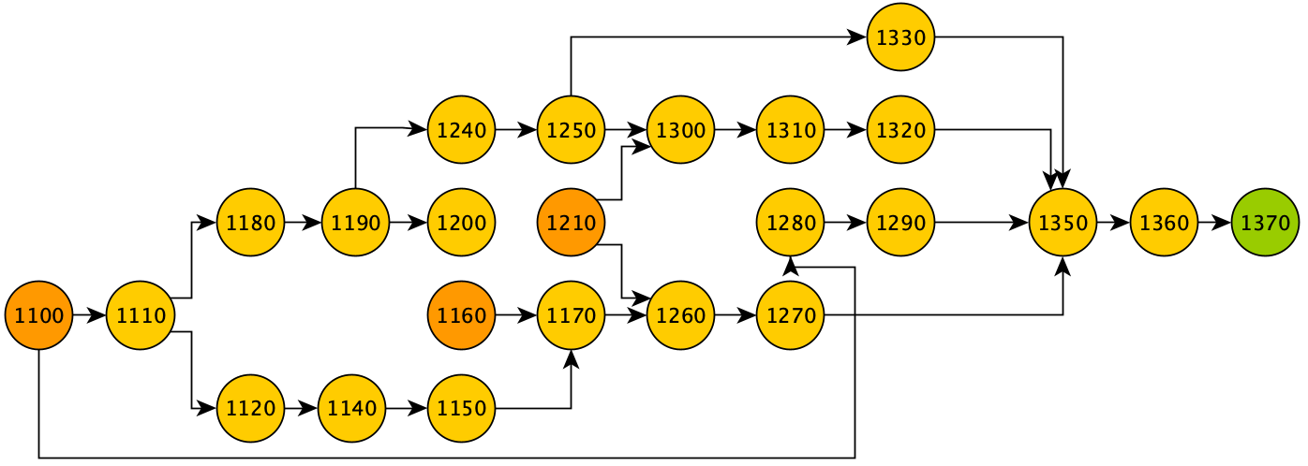
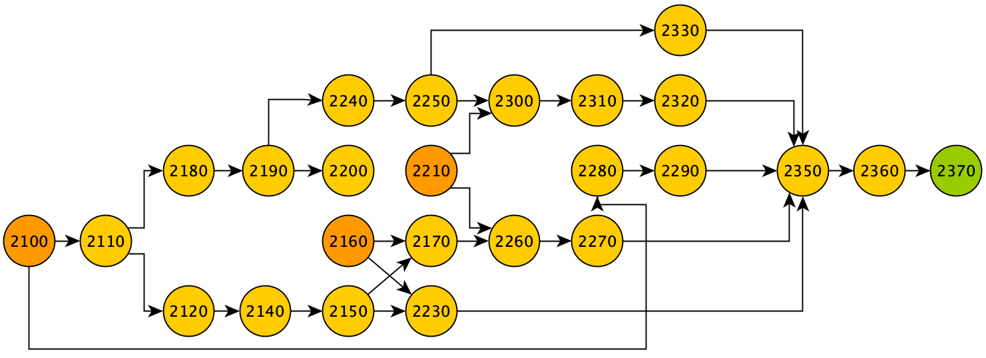
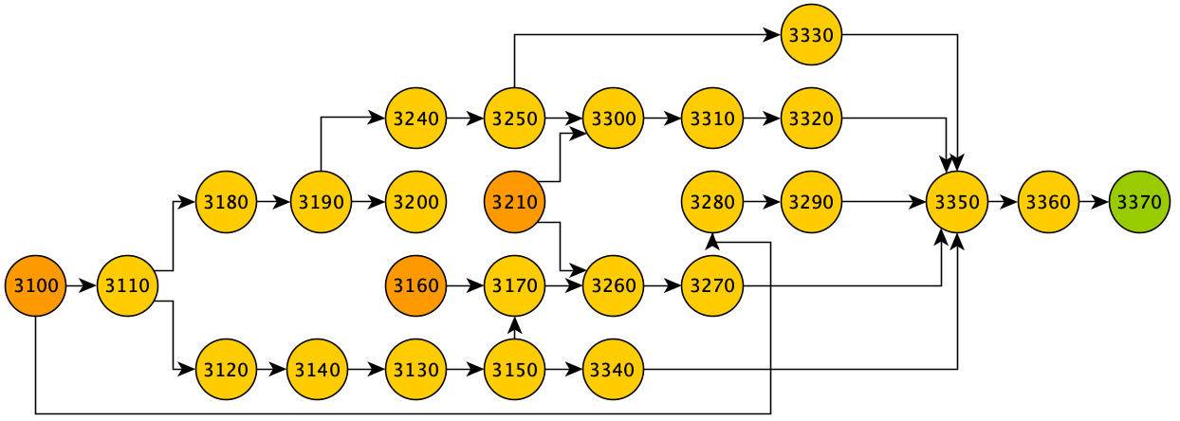
Precedence Diagrams
These diagrams portrays the logical sequence of tasks for bike assembly.
Things to note:
Provides a visual schedule of activities
Does not tell where each task should be performed

Slide 7


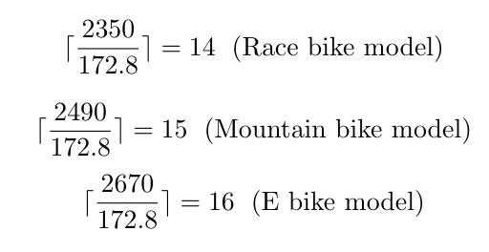
Calculating Our Ideals
Given Parameters:
Takt Time: Ideal processing time at each station
Minimum Number of Stations: TP/ Takt Time

Slide 8
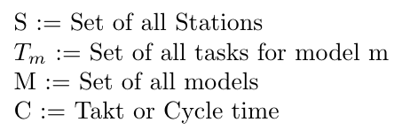
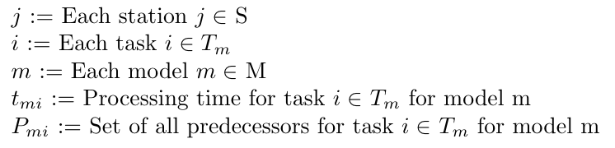
Optimization with Gurobi
Setting up the problem:
Parameters:
Indices:

Slide 9
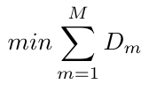
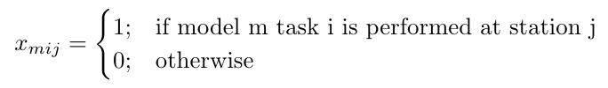
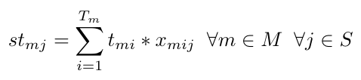
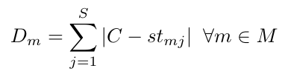
Optimization with Gurobi
Variables
Objective Function and Constraints
There are other objective functions that could be used such as minimizing cycle time and minimizing the number of stations.
Our Minimums:
18 Stations *
92.3 sec Cycle time
Primary Decision Variable
Total Processing time at each station
Difference from Takt time for each station

Slide 10
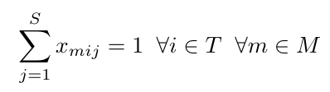
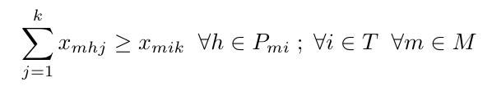
Optimization with Gurobi
Objective Function and Constraints Contd.
To ensure each task is assigned to only one station.
To ensure all predecessors h for task i are performed at the same or a previous station as task.
If tasks are the same for each bike type, ensure these tasks are at the same station.

Slide 11
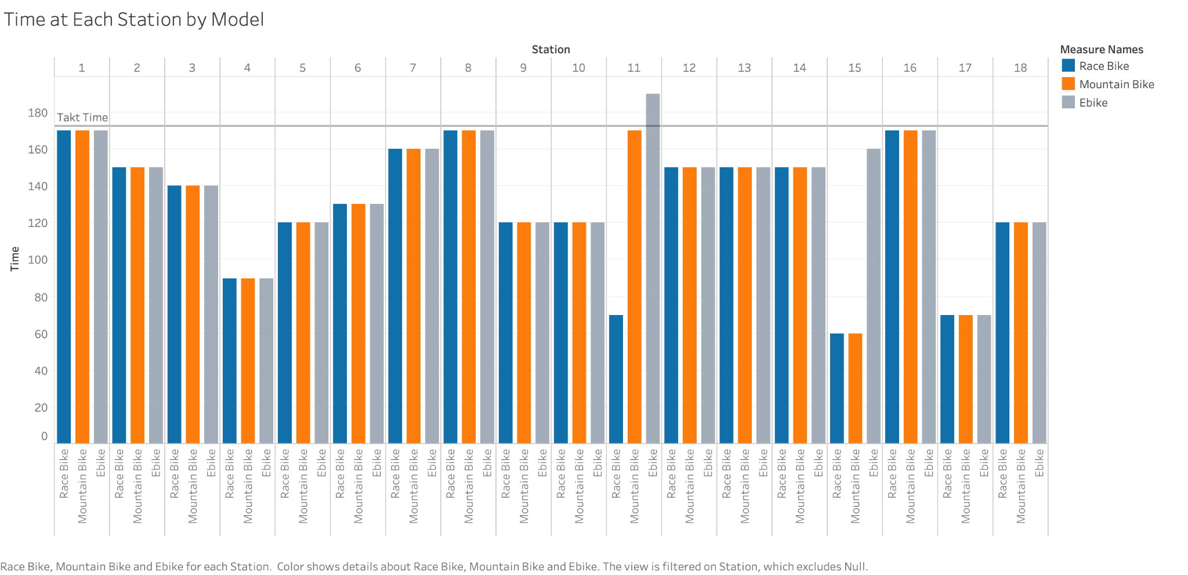
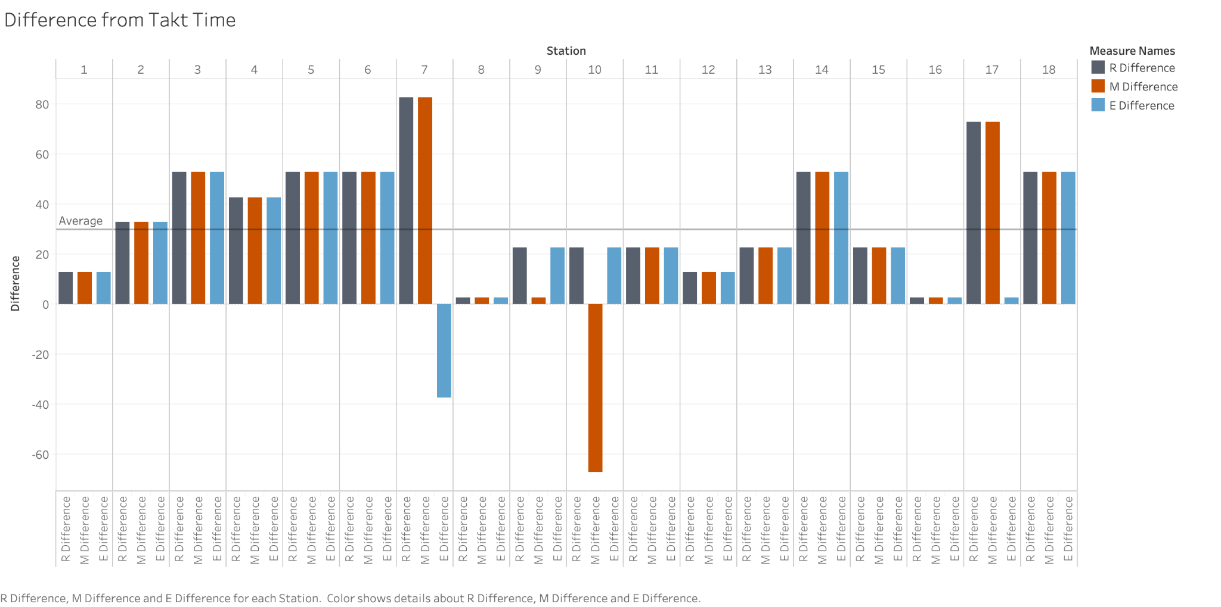
Optimal Solution Analysis

Slide 12
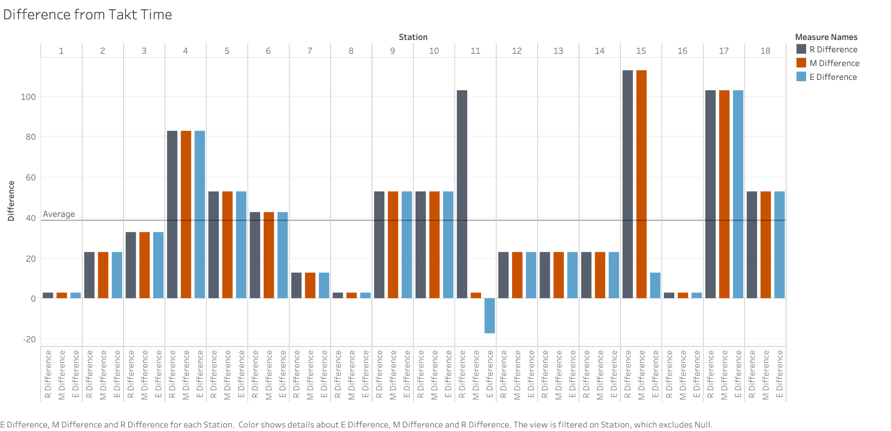
Optimal Solution Analysis
Average = 38.0

Slide 13
Sequencing Optimization

Slide 14
Objective:
Level the time between each bike in the sequencing order of the daily production. In this scenario we should ultimately have a sequence that minimizes idle time at each station.

Slide 15
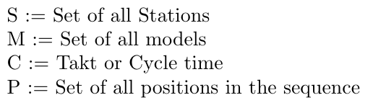
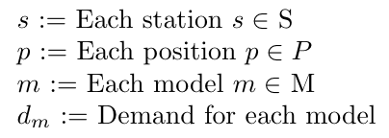
Optimization with Gurobi
Setting up the problem:
Parameters:
Indices:

Slide 16
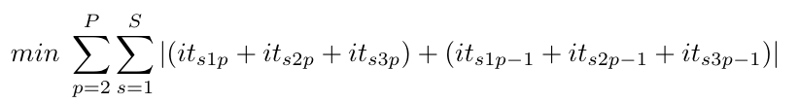
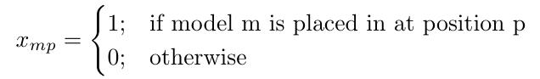
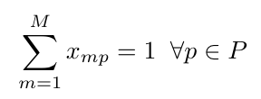
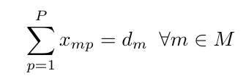
Optimization with Gurobi
Variables
Objective Function and Constraints
Primary Decision Variable
To ensure every position is only assigned one of the models
Idle Time at each station
To ensure demand is met for each bike type

Slide 17
Sequences in Sequencing1.xlsx
Optimal
This is the optimal Sequence from Gurobi
Min Average
Uses slightly different objective function that minimizes the average between each station
Creates a batching sequence Due to low variation in between the bike types
Random
Random order of bike types
Offers some more variation for analysis in the simulation model
Deliverable 4

Slide 18
Optimal Solution
Analysis
After running Gurobi:
Balancing problem:
Explored 1 nodes (929 simplex iterations) in 0.09 seconds
Thread count was 8 (of 8 available processors)
Solution count 1
Sequencing problem:
Explored 0 nodes* (1047 simplex iterations) in 0.05 seconds
Thread count was 8 (of 8 available processors)
Solution count 2
*This means the optimal solution is found in the root node

Slide 19
Simulation

Slide 20
Measuring Variance Between Models
Station Utilization
Compare station utilizations for each station
Cycle Time
Measure cycle time of each bike coming off the assembly line
Take average as Output Data
Idle Time
Measure the idle time at each station or the difference between takt time
Deliverable 4

Slide 21
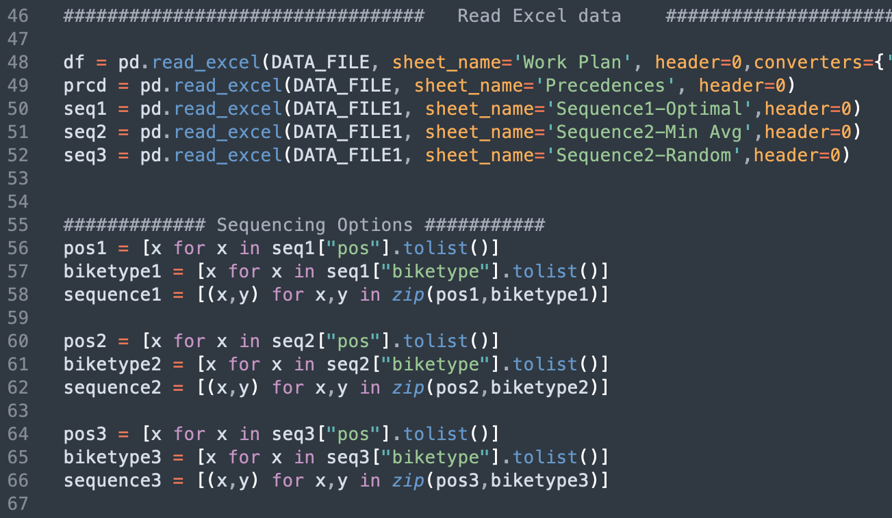
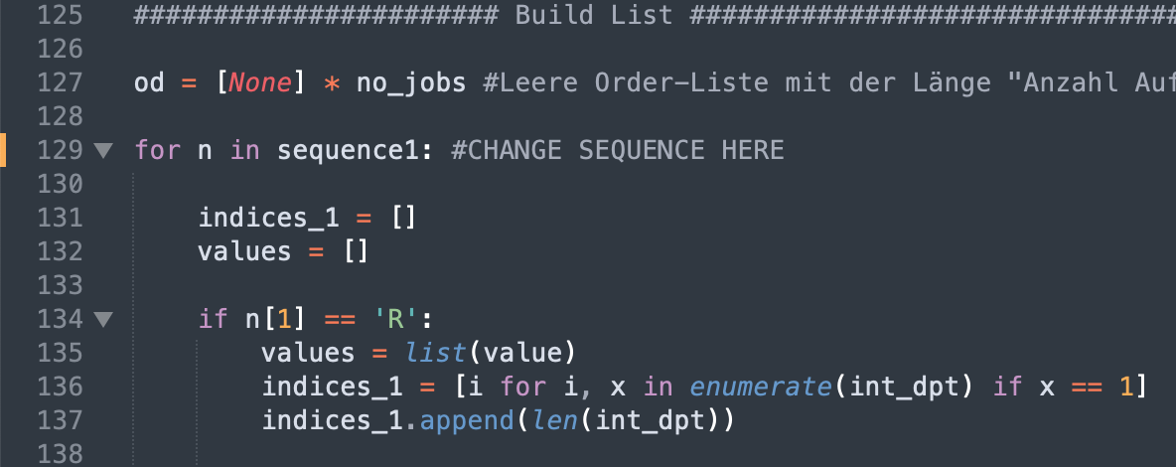
Input Data Generator
Sequence Options
Advanced projects
Change Sequence

Slide 22

Author
Etienne Batiste
2022 B.S. Industrial and Systems Engineering Candidate at the Georgia Institute of Technology in Atlanta, GA

